Slide 1


INTERNATIONAL SYMPOSIUM ON
IBD RESEARCH
FUNDED BY PATIENTS' ORGANISATIONS
“ROADMAP”
Crohn’s and Colitis Foundation of Canada
Dr. Kevin Glasgow, Chief Executive Officer
Brussels 18 October 2012
Hotel Métropole
EVENT ORGANIZED BY EFCCA

Slide 2

:
OVERVIEW
What is the CCFC?
CCFC Research
GEM Project
Impact of IBD in Canada Report
Conclusion

Slide 3

:
WHAT IS THE CCFC?

Slide 4

CCFC / FCMII
Founded in 1974 by concerned parents
Canadian registered charity
National Board of Directors
65,000 supporters
~ 80 volunteer chapters/groups nationally
$12 M CAD p.a. revenue (~ €9.5 M)

Slide 5
CCFC Promise Statement
To cure Crohn’s disease and ulcerative colitis and to improve the lives of children and adults affected by these diseases

Slide 6
CCFC’s Promise Programs
RESEARCH
EDUCATION
ADVOCACY
  CCFC Mission Programs

Slide 7
:
CCFC RESEARCH:
Prevention, Treatment, Cure and Health Policy

Slide 8
CCFC Research
CCFC is very research intensive
  ~ ½ revenue goes to research (~€5 M p.a.)
  chapters have research fundraising targets
Canada’s #1 funder of IBD research
#2 absolute funder in global VHO sector
#1 per capita research funder in VHO sector
> $76 M (~€60 M) in research funding
Peer Review + Lay Review

Slide 9
Research Portfolio
GENERATING NEW IDEAS
Stimulate and encourage advances in IBD research
Gov’t Partnerships
BUILDING THE IBD RESEARCH COMMUNITY
Investing in the next generation of IBD scientists
Studentships
PROMOTING KNOWLEDGE EXCHANGE
Translating research knowledge to clinical benefit and across borders
Innovations in IBD
Vertex Partnership
Summer studentships
Salary
Future Directions
Conference grants
Fellowships
GEM Project
Impact of IBD Report
Grants in Aid
2 Endowed Chairships
Visiting Scientists

Slide 10

:
GEM PROJECT
Multidisciplinary Human Study on the Genetic, Environmental and Microbial Interactions that cause IBD

Slide 11

Genetic Environmental Microbial (GEM)
Globally unique, major, long-term, multi-centre prospective clinical cohort research study
One-of-a-kind landmark study investigating the genetic, environmental and microbial factors that lead to Crohn’s disease
Potential for broad-reaching benefits to international IBD community

Slide 12

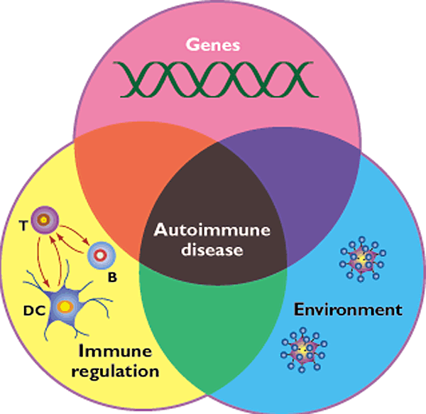
What causes Crohn’s Disease?
201,000 Canadians living with IBD: 112,000 with CD and 88,500 with UC
www.gemproject.ca
Notes:
12
12
12

Slide 13
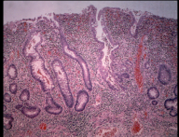
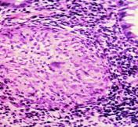
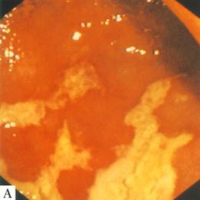
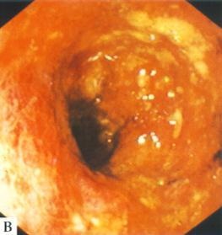
Ulcerative Colitis - Crohn’s Disease
In Search for the Cause
Case Control studies

Slide 14


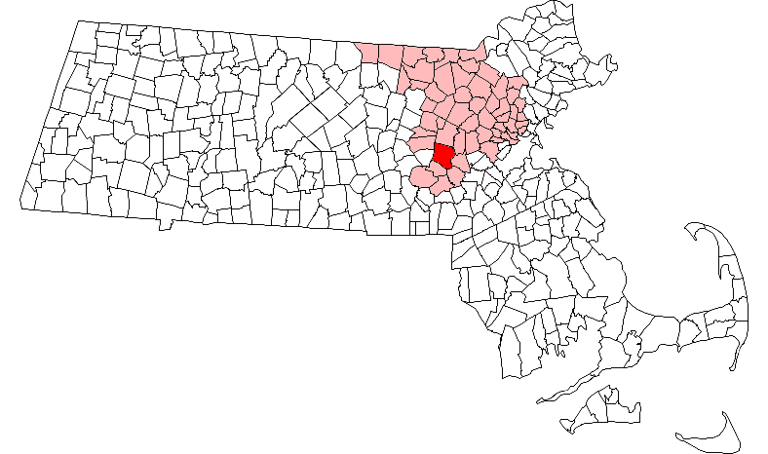

Framingham, Mass.
Study began in 1948 by recruiting an Original Cohort of 5,209 men and women between the ages of 30 and 62 from the town of Framingham, Massachusetts, who had not yet developed overt symptoms of cardiovascular disease or suffered a heart attack or stroke.
Since that time the Study has added an Offspring Cohort in 1971, the Omni Cohort in 1994, a Third Generation Cohort in 2002, a New Offspring Spouse Cohort in 2003, and a Second Generation Omni Cohort in 2003.

Slide 15
Highlights of Framingham Study:
Significant Milestones
1948 Start of the Framingham Heart Study
1956 Findings on progression of rheumatic heart disease
1959 Factors found that increase the likelihood of heart disease. Some heart attacks discovered to be "silent" (causing no pain)
1960 Cigarette smoking found to increase the risk of heart disease
1961 Cholesterol level, blood pressure, and electrocardiogram abnormalities found to increase the risk of heart disease
1967 Physical activity found to reduce the risk of heart disease and obesity to increase the risk of heart disease
1970 High blood pressure found to increase the risk of stroke
1976 Menopause found to increase the risk of heart disease
1978 Psychosocial factors found to affect heart disease
1988 High levels of HDL cholesterol found to reduce risk of death
1994 Enlarged left ventricle (one of two lower chambers of the heart) shown to increase the risk of stroke
1996 Progression from hypertension to heart failure described

Slide 16
Development and Milestones of GEM Project
Discussions and Development of Key Project for CCFC –IBD 2005
CCFC Submission March 7, 2006
Site Visit with External Review Committee Jan 20, 2007
Letter of Notification of Award March 15, 2007
1st Meeting of GEM Executive/Operating Committee
  March 30, 2007
1st Meeting of GEM Steering Committee
  June 18, 2007
1st Meeting of Clinical Recruitment Centers
  Nov 5, 2007
REB submissions
  Dec 2007 - ongoing
Study Initiation Meeting
  Feb 11, 2008
Site Initiation and Subject Recruitment
  March 2008

Slide 17
Steering Committee
Gil Kaplan | Paul Beck | Charles Bernstein | Alan Bitton
Ken Croitoru | Leo Dieleman | Brian Feagan | Anne Griffiths
Denis Krause* | Kevan Jacobson | Mark Ropeleski | Andy Stadnyk
Ernie Seidman | Karen Madsen | Paul Moayyedi | Kathy Siminovitch
Hillary Steinhart | Bruce Vallance | Mark Silverberg | Tom Walters
Denis Snider | John Marshall | Dan Turner¹ | David Guttman
Michael Surette

Slide 18
The Research Team
Steering Committee
Chair: Ken Croitoru
Operating Committee
Project Leader: Ken Croitoru
Deputy Leader: Anne Griffiths
Mark Ropeleski; Paul Moayyedi
National Project
Coordinator
Working Groups
Data Monitoring
Ethics Committee
Publication and
Policy Committee
Regional Coordinators
Secondary Research
Liaison

Slide 19

Goals of the GEM Project
Genetic
Environmental
Microbial
Notes:
19

Slide 20
GEM Study Design
Year
1
2
3
4
5
6
REB Approval
DATABASE
Subject Recruitment:
unaffected siblings/offspring
Subject Monitoring:
0.3 % incidence per year =35-74 cases
2008
Selection of Control:
Control – (4x) = 150- 296 subjects

Slide 21
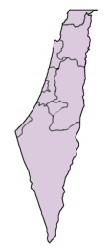
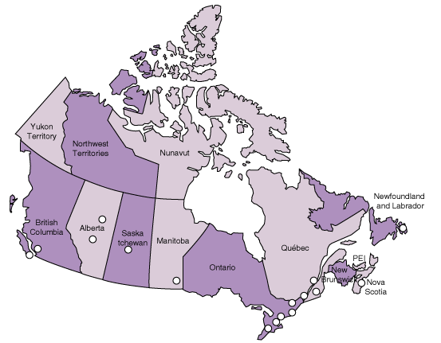
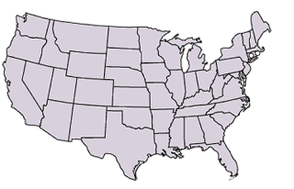
Sites
Israel
Canada
Recruitment Cities
United States
Pending Cities

Slide 22
Study Execution
Recruitment Sites
Subjects
Database
Study Management System
Global Project Office
Central Processing Lab
Storage
Tissue Bank
Publication
Data
Analysis

Slide 23
Study Design
Subject monitoring
0
Year
1
2
3
4
5
6
Identify Proband Identify Sibling
Screen for disease
Recruitment and collection of -
Demographic Data
Environmental Questionnaire
FFQ
Permeability Assay
Blood Samples
Stool Samples
Analysis of -
Demographic Data
Environmental Questionnaire
FFQ
Permeability Assay
Blood Samples
Stool Samples
Phone Call
Contact
Subject
GP
**Disease Development
Re-Sampling

Slide 24
Biological Sampling
Blood samples
EDTA (6 ml)
3 PBMC samples
Stool samples
1 stool sample
SST (8.5ml)
ACD (2x 8.5ml)
4 equal serum samples
1 DNA Sample
3 stool biopsies
Urine samples
1 x 5ml aliquot
Urine Permeability sample
(24 hour collection)
2 x 5 ml aliquots
Metabolomics (mid-stream)
Demographics
Environmental Risk Analysis
Food Frequency Questionnaire

Slide 25
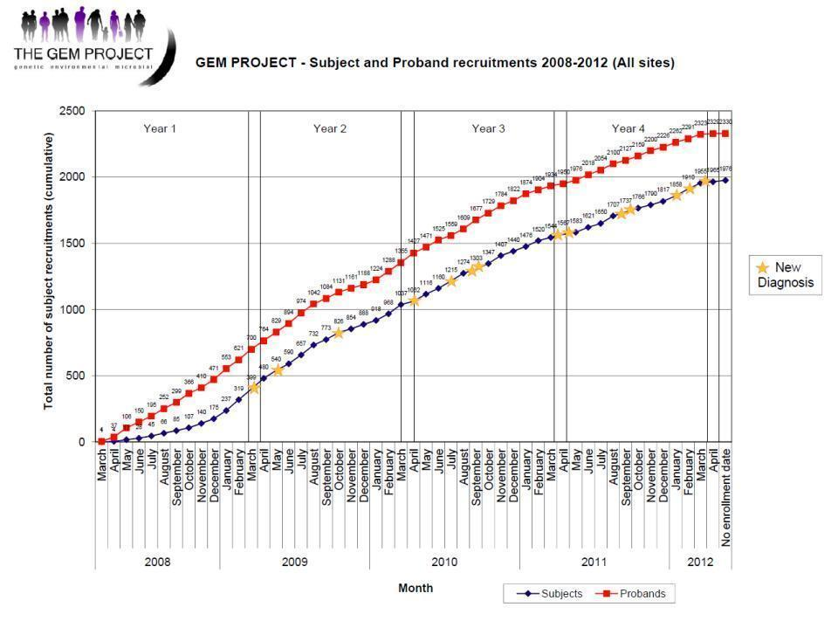

Slide 27

GEM Project:
the Perfect Storm!
Scientific Advances
Technological Advances
Bioinformatic Analysis
Collaborative Opportunities

Slide 28
Cause of IBD
www.gemproject.ca
Notes:
28
28
28

Slide 29
Cohort is enriched for subjects carrying genes associated with risk of Crohn’s disease
 | CD | FDR | UC/IC | HC
Mean risk score (SD) | 20.22 (3.59) | 19.89 (3.47) | 18.91 (3.42) | 18.45 (3.46)
MRS Difference (p) | 0.33 (0.07) | N/A | 0.98 (1.12E-7) | 1.43 (1.55E-16)
Mean risk scores for each cohort and their differences compared to FDRs.

Slide 30


Environmental Factors
T cells have α7nicotiinic receptors – incr Th1 responses
30

Slide 31
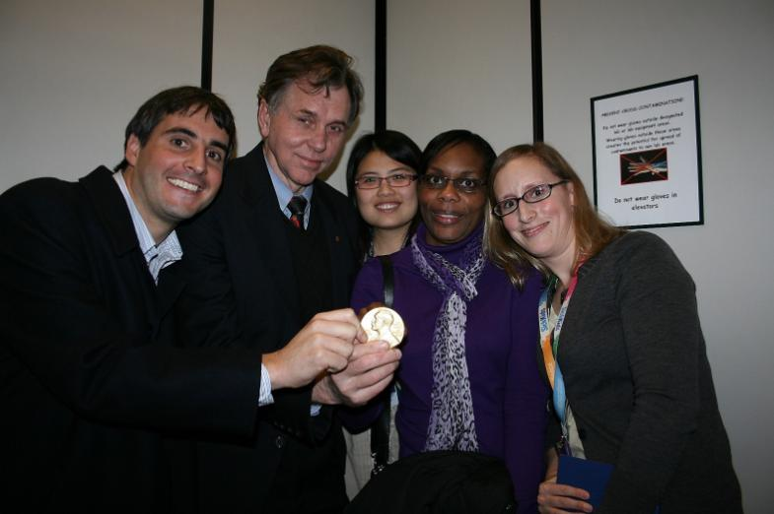
Barry Marshall visiting University of Toronto, 2009
31

Slide 32
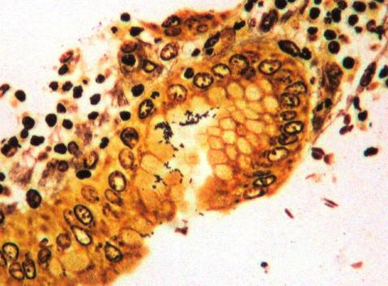
Helicobacter pylori

Slide 33

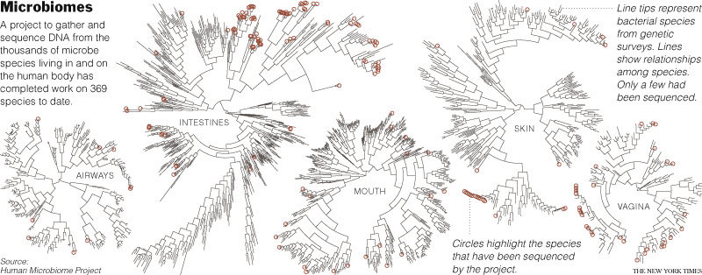

Slide 34

CIHR Human Microbiome Initiative-Emerging Team Grant
Title: Influences of the Host Genome on the Human Gut Microbiome: Studies in a Healthy
Cohort Carrying Crohn's Disease Risk Alleles
PI: Ken Croitoru
Co-PI’s: Mark Silverberg, Denis Krause
Co-I’s: Gabriel Moreno-Hagelsieb, Andrew Paterson, Wei Xu, Dennis Cvitkovitch,
Overall Objective: To analyze the unique cohort of healthy FDRs (GEM) to determine the potential association of gut microbiome “phenotype” with host genetic differences, using modern technology and computational approaches as genome-wide association and 16S rDNA pyrosequencing.
Aim 1: to catalogue the relative abundance of frequent microbial genomes in the gut microbiome of FDR of Crohn’s disease subjects.
Aim 2: to identify single nucleotide polymorphisms (SNPs) associated with differences in the relative abundance of frequent microbial species by performing:
a. GWA studies on the cohort of healthy FDR – an hypothesis free approach.
b. analysis of genes selected from the GWA and know CD associated –risk alleles
Aim 3: To define the relationship between the relative abundance of frequent microbial species and selected physiological and environmental factors and including:
a. intestinal permeability
b. anti-microbial serology
c. diet and environmental risk factors
Aim 4: to determine, by metagenomics, the specific metabolic capabilities of selected unique microbial communities found to be influenced by the genetic and physiologic factors defined above.

Slide 35
Personalized Medicine-
Defining the Patient vs. the Disease
Genotype Profile
Risk Alleles
Specific Sequences
160 risk alleles+
Immune Profile
Anti-microbe activity
Th17 vs Treg profile
Microbial Ag Chip
Mutliplex analysis
Metagenomic Enterotypes
Functional Microbiome-
Transcriptomics
Specific Microbes
Microbiome Profile
GEMomic determination of Patient Profile defines
the Treatment Strategy

Slide 36


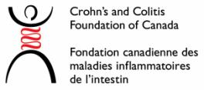
Thank you, CCFC donors!
www.ccfc.ca
Notes:
36

Slide 37
GEM – Where are we today?
Over 2,000 participants (healthy first-degree relatives of people with IBD) enrolled
Proof-of-principle established (14 participants have developed CD)
32 recruitment centres across Canada, United States & Israel
Solely funded by CCFC ($5.5 M over past 5 years)

Slide 38
GEM Project – What now?
Canada is sole funder, but this must change
  CCFC is funding Canada, USA, Israel
European and Australia/NZ interest
CCFC can’t fund the world alone
  Need for USA, Israel, Europe, Down Under $
  Future site expansion tied to new $
5 year international peer review this autumn
Potential CCFC bridge funding for up to two years

Slide 39
GEM Project – The Future
Two things are needed:
  More funding for core cohort infrastructure
  More recruitment sites (tied to #1)
The sooner more subjects are recruited, the sooner results will be obtained
European involvement (with funding) welcomed
GEM Project will likely go on for decades
  Results are mid- and long-term
Too valuable to let fail
  CCFC is funding Canada, USA, Israel
European and Australia/NZ interest
CCFC can’t fund the world alone
  Need for USA, Israel, Europe, Down Under $
  Future site expansion tied to new $
CCFC bridge funding for up to two years

Slide 40
GEM Project – Expected Results
Identification of the environmental triggers underlying Crohn’s disease
  Prevention
  Treatment
  Cure
Ulcerative colitis spill-over knowledge
Expect the unexpected
  CCFC is funding Canada, USA, Israel
European and Australia/NZ interest
CCFC can’t fund the world alone
  Need for USA, Israel, Europe, Down Under $
  Future site expansion tied to new $
CCFC bridge funding for up to two years

Slide 41
:
IMPACT OF IBD IN CANADA

Slide 42
Impact of IBD in Canada Report
Commissioned by CCFC and led by Scientific Steering Committee
Research review of the burden of IBD in Canada
Launch November 2012 – Crohn’s and Colitis Awareness Month in Canada

Slide 43
Impact of IBD Report
Describes the current state of IBD in Canada (with international citations), including:
    epidemiology
      Canada – amongst world’s highest rates
    direct medical costs
    indirect costs
    quality of life / humanistic burden

Slide 44
Impact of IBD Report
Conclusions
  Incidence & prevalence of IBD is rising, particularly among children under 10
  Burden and costs that IBD places on individuals, the healthcare system and society is significant and growing
  Adults and children living with IBD face a number of critical challenges

Slide 45
Impact of IBD Report
Recommendations for advocacy priorities
  Increase government funding for IBD research, education, and awareness
  Ensure timely and equitable access for IBD medications and treatments
  Improve public bathroom access for those living with IBD

Slide 46
:
CONCLUDING REMARKS

Slide 47
Hands across the ocean
GEM Project needs to be sustained
  This is a global fight against IBD
    No individual country holds all the answers
  CCFC/Canada is interested in working more closely with our global patient organisation colleagues
  CCFC supports greater investment in IBD research
  Let’s learn from each other

Slide 48
:
A la prochaine …
www.ccfc.ca
www.fcmii.ca
www.cantwait.ca
www.gemproject.ca

